Slide 1
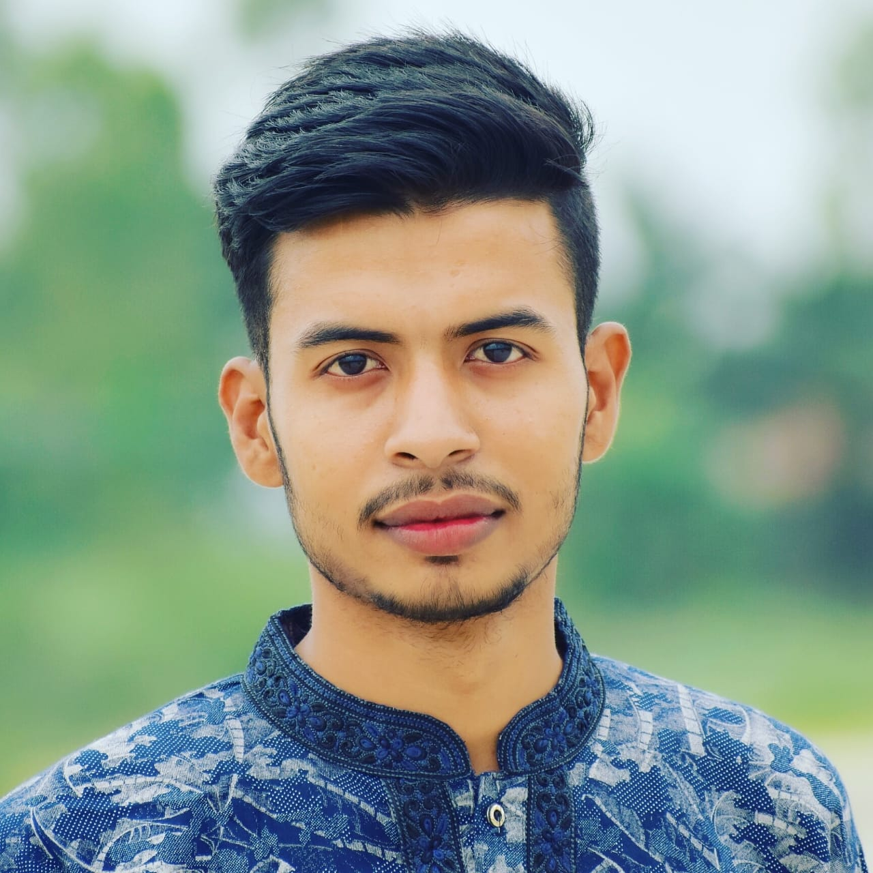
Student

Slide 2
MD.NAIMUR RAHAMAN NAIEM
STUDENT

Slide 3




MD.NAIMUR RAHAMAN NAIEM
GRAPHIC DESIGNER
PROFILE
Seeking innovation and challenging career in a growing organization.
CONTACT
naiem5009@gmail.com
01717098304

Slide 4




EDUCATION
Present
2023,Patuakhali B.SC.Engineering in CSE
BANGLADESH PATUAKHALI SCIENCE & TECHNOLOGY UNIVERSITY
Higher Secondary
2018-2020 HSC (5.00)
BANGLADESH Armed police battalion public school and college
Secondary
2015-2018 JSC (5.00) – SSC (5.00)
BANGLADESH Kahaloo High School
Primary
BANGLADESH Ulotto primary school
MD.NAIMUR RAHAMAN NAIEM
GRAPHIC DESIGNER
ACHIVEMENT
PROFILE
BADHON-Blood Donar Certificate-PSTU
Seeking innovation and challenging career in a growing organization.
CONTACT
SKILLS
naiem5009@gmail.com
C
Problem Solving
Graphic Designing
Excel
PowerPoint
Communication
Colaborotion
01717098304

